Slide 1
IT1102
Computer Hardware
Week 6
Backup and Restore Tools

Slide 2
Backups
Backups help ensure that your files aren't permanently lost or damaged.
With automatic backups, user don't have to remember to back up files
You can change your automatic backup settings (such as how often you back up, the type of storage you use, or the types of files you back up) whenever you want.

Slide 3
Backups
Start button
Control Panel
System and Maintenance
Backup and Restore.
Click Set up backup
Follow the steps in the wizard
Administrator permission required

Slide 4
Backups
If it's time for your regularly scheduled backup and your computer is off, sleeping, or hibernating, Windows Backup skips the backup and waits for your next scheduled backup.
If the backup destination isn't available when Windows Backup tries to create your backup, you get an error message. You can either change the backup destination, retry the backup, or wait for your next scheduled backup.

Slide 5
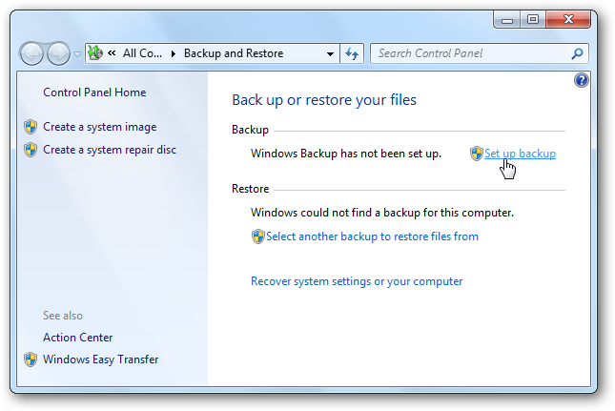
Backups
Daily backups after the work of each day is best backup plan for Windows

Slide 6
Restore point
A restore point is a saved "snapshot" of a computer's data at a specific time.
When a restore point is established, your computer creates a backup copy of all data at that particular time
By creating a restore point, user can save the state of the operating system and user own data so that if future changes cause a problem, user can restore the system and user data to the way it was before the changes were made.

Slide 7
Creating Restore point
Open System by clicking the Start button
Right-clicking Computer, and then clicking Properties.
In the left pane, click System protection. Administrator permission required
Click the System Protection tab, and then click Create.
In the System Protection dialog box, type a description, and then click Create.

Slide 8
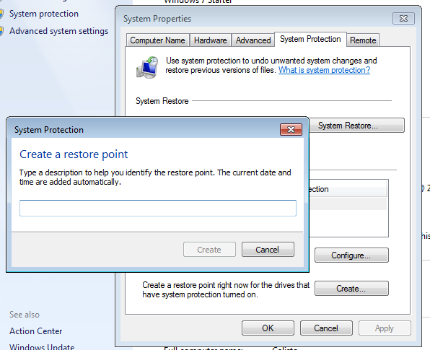
Creating Restore point

Slide 9
Restore from backup
Open Backup and Restore by clicking the Start button
Control Panel
System and Maintenance
Backup and Restore
Restore my files / Restore all users
To browse the backup, click Browse for files or Browse for folders.

